Slide 1


B.Tech Computer Science and Engineering – Vth Semester
Theory of Computation
Department of Computer Science and Engineering

Slide 2
Pushdown Automata - PDA
NFA, e NFA and DFA are recognizing machines for Regular languages (Defined by Regular Expressions).
Pushdown Automata is the recognizing machine for Context Free Languages (Defined by Context Free Grammars).
There are some languages which are not context free , those languages cannot be accepted or recognized by PDAs

Slide 3
PDA an Informal Introduction
PDA is essentially a epsilon NFA.
It has got an additional feature called as stack
Stack is the same data structure we know already.
We can read, push and pop elements on the top of the stack.
Through this stack PDA can remember a finite amount of information.

Slide 4
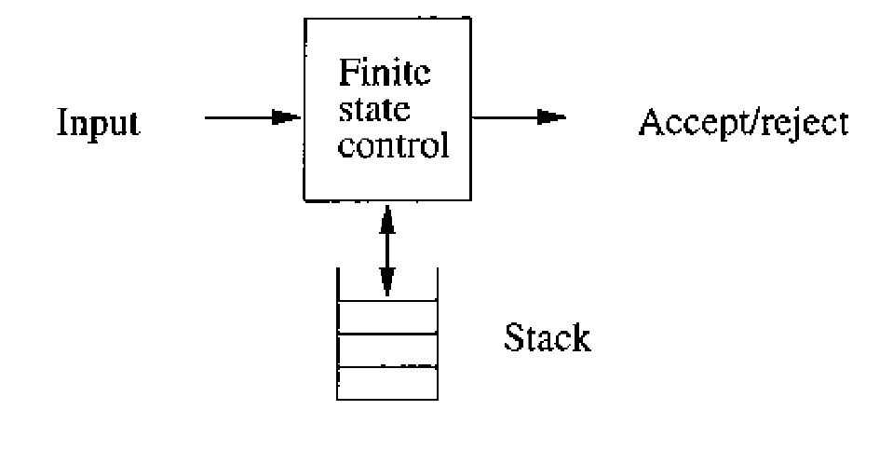
PDA
Like NFAs, PDA s also has states and moves from one state to another on reading an input.
For every transition it consumes the input and moves to state which may or may not be the same state.
If ε is the input symbol then no input is consumed.
For every transition the PDA replaces the symbol at top of the stack.

Slide 5
Stack Replacement in the PDA s transions
PDA replaces the symbol on the top of the stack.
If the symbol is ε then the stack is poped.
The replaced symbol and the symbol previously on the top of the stack can be same. (No change in the stack top).
The stack top can be replaced by other symbol. (No push , No pop)
The stack top can be replaced by two or more symbols. (stack top is replaced with one symbol and the other symbols pushed one after the other on to the stack)

Slide 6
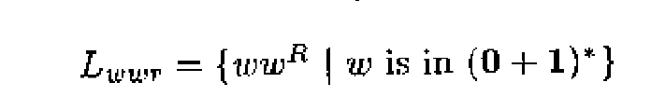
Let us consider the language for palindromes
P-> ε
P->0P0
P->1P1
we assume the inputs like
{1ε1,0ε0, 10ε01,01ε10,….}

Slide 7
Stack Replacement in the PDA s transions
PDA replaces the symbol on the top of the stack.
If the symbol is ε then the stack is poped.
The replaced symbol and the symbol previously on the top of the stack can be same. (No change in the stack top).
The stack top can be replaced by other symbol. (No push , No pop)
The stack top can be replaced by two or more symbols. (stack top is replaced with one symbol and the other symbols pushed one after the other on to the stack)

Slide 8
Description of a PDA
The instantaneous description of a PDA
Q-> Set of states.
∑ -> Set of Input symbols.
Ϯ ->A finite stack alphabet.
δ-> transition function.
q0-> start state – PDA starts its transition here.
Z0-> start symbol- PDA sees this on the stack initially.
F-> set of final or accepting states.

Slide 9
The transition function
δ(q,a,X)=(p,γ)
q-> is the current state of the PDA.
a-> the current input symbol being read.
X-> is the symbol on the stack.
The output will be (p,γ)
p is the next state.
γ is the string to be pushed to the stack.
If γ=YZ the Z replaces the stack top X and then Y is pushed on to the stack which makes Z to move to the second position.

Slide 10
The transition function
δ(q0,0,Z)=(q0,0Z) and δ(q0,1,Z)=(q0,1Z)

Slide 11
Sample Functionality of PDA
input | action | Stack
110e011 | push | Z0
10e011 | push | 1 | Z0
0e011 | push | 1 | 1 | Z0
e011 | move to another state | 0 | 1 | 1 | Z0
"011" | pop | 0 | 1 | 1 | Z0
11 | pop | 1 | 1 | Z0
1 | pop | 1 | Z0
null | Move to the accepting state- accept | Z0
YZ | X
Y | Z
 | Y | Z

Slide 12
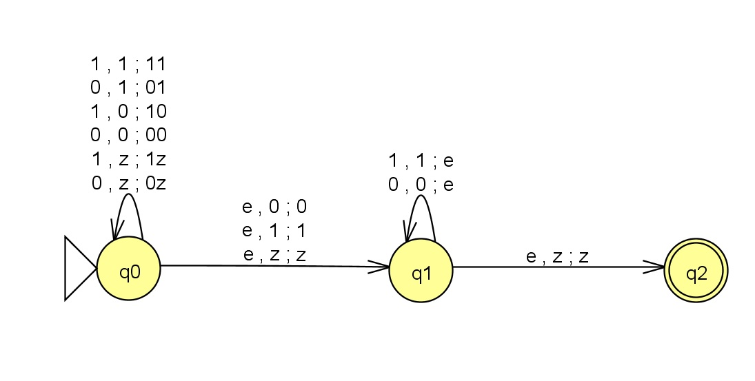
The Resultant PDA

Slide 13
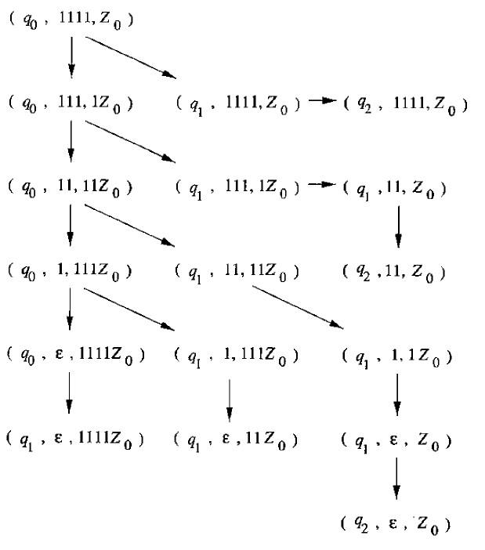
The transition of the PDA for input 1111

Slide 14
Instantaneous Description of Automata
Let P be the PDA (Q,∑, Γ,δ,q₀,Z₀,F)
If (q,a,X) contains (p, α) i.e δ(q,a,X) = (p, α)
δ (q,aw,Xβ) Ⱶ (p,w,αβ)

